Slide 1
CS 151 Project: Tile Puzzle Game
Team Members:
Amir Radman
John Humlick
Stephen Reyes

Slide 2
Objective:
We will create a tile puzzle game where the user provides an image file and the tile grid dimensions to break the image up into.
The program breaks up the image into icons, replacing one of the icons with a blank tile, and then proceeds to shuffle the icons around on the frame.
The user then can move tiles adjacent to the blank tile into the blank tile, shifting the blank tile into the location formerly occupied by that tile.
Once the user arranges all of the tiles in the correct order, the tiles will disappear and be replaced by the original image, thus leaving the puzzle solved.

Slide 3
Concepts Used
Patterns:
  Observer
    Tile locations will be stored in a data model that will change when a tile is moved
  Decorator
    We will implement menus for the frames we draw
  Composite
    Our tiles are small components that make up a larger component in the frame
  Strategy
    Our tiles will utilize the strategy pattern to create either image icons, or a blank tile icon used for the blank tile.
Other Concepts:
  GUI
    Icons
      We will break up an image into icons for our tiles
  Action Events
    Moving tiles will generate an action
  Timers
    We will display the initial image before switching to the puzzle frame utilizing timers.

Slide 4
Demonstration
Run the program and show the features

Slide 5
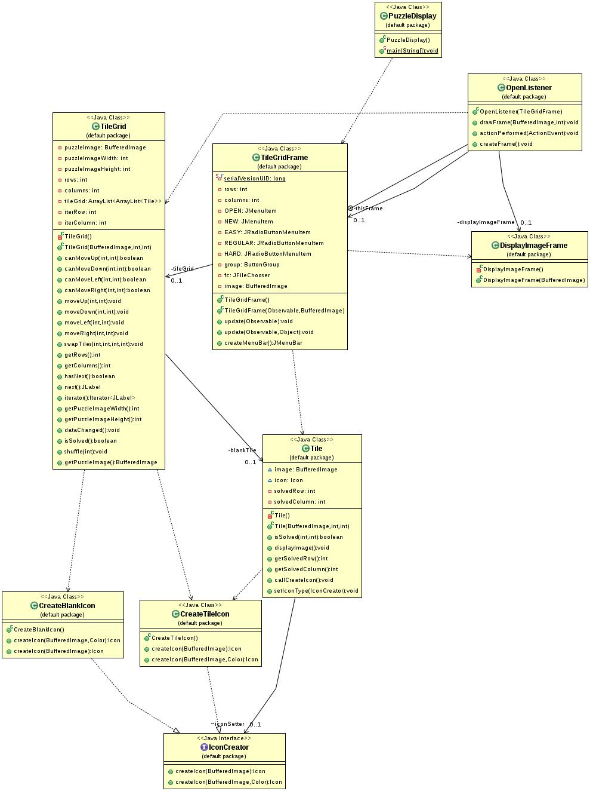

Slide 6
UML Relationships
Tiles, TileGrid, and TileGridFrame
  Tiles are our main data class
  TileGrid aggregates Tiles, and knows their location
  The TileGridFrame depends on the TileGrid to determine where to draw each icon, and depends on the Tiles to know which icon to draw per tile
  Only the Tiles know where the final positions will be

Slide 7
UML Relationships
PuzzleDisplay, TileGridFrame, and DisplayImageFrame
  The Puzzle Display depends on the creation of an “empty” TileGridFrame
  TileGridFrame creates a DisplayImageFrame before displaying the puzzle and when the puzzle is solved
  Constant cycle of frames being created and disposed as the puzzles are opened and solved

Slide 8
UML Relationships
IconCreator, CreateBlankIcon, CreateTileIcon, and Tile
  CreateBlankIcon and CreateTileIcon implement the IconCreator interface, and determine what is displayed in the Tile
TileGridFrame and OpenListener
  OpenListener creates a new puzzle when the timer for the initial display frame runs out

Slide 9
Pattern Implementation
Decorator
  We need a way for the user to choose which image the puzzle will use, choose to restart the puzzle, and set the difficulty/shuffling of the puzzle.
  We could add components to the current frame, but that would affect the calculations needed for the tiles.
  We could create a separate frame/panel but this would clutter up the screen/frame.
  What other item could we add that would not affect the current look and function of the puzzle?

Slide 10
Pattern Implementation
Decorator
  We add menus to the frame
    We use the TileGridFrame to create a JMenuBar to attach to itself
  The JmenuBar that is created by the TileGridFrame class holds all the functionality of creating a new game with either a selected image or the current image, and radio buttons (one option at a time) to change the difficulty of the game.

Slide 11
Pattern Implementation
Composite
  How can we keep track of all the tile and images for those tiles in the puzzle?
  How can we keep track of the different choices that can be made about the difficulty of the puzzle?

Slide 12
Pattern Implementation
Composite
  We add JPanel components with icons inside of them to the frame using GridLayout
  TileGridLayout composed of Tiles which held the data for our images
  To create the options for the difficulty level, we create a ButtonGroup that has composites of JradioButtonMenuItem, even though each item has slightly different functions.

Slide 13
Pattern Implementation
Observer
  TileGrid extends Observable
    holds data
  TileGridFrame implements Observer
    displays data
With this implementation, we can also implement a text observer and display the puzzle using ascii characters

Slide 14
Pattern Implementation
Strategy
  We need to have tiles that display images and a tile that is blank. What is the best solution?
  Should we make a tile class and have an image tile class and blank tile class that extend it?
  What if we need to implement numbered tiles?

Slide 15
Pattern Implementation
Strategy
  We implemented a IconCreator interface
    This interface requires a createIcon method
  Our Tile class has an IconCreator object
  When we need the tile to generate an icon, we call the method from the IconCreator object
  We have a set method, that can change the reference to the IconCreator object, and two concrete classes that implement it: CreateTileIcon and CreateBlankIcon

Slide 16
Other Concepts Used
Icons
  We first break the image up into BufferedImage subImages
  Then we convert the subImages into Icons that can be displayed with JLabel
  In the case of the blank tile, we use Graphics2D to draw a solid color into the tile

Slide 17
Other Concepts Used
ActionEvents
  Clicking on a tile generates an action event
  We calculate the row and column of the tile clicked
  We then see if that tile can move up, down, left, or right by checking if the blank tile icon exists there

Slide 18
Other Concepts Used
Timers
  How can we display the full image in a frame, then switch to the puzzle after a specified time?
  We tried using a Timer from the java.util package, but we came up with a bug with the display of the full image

Slide 19
Other Concepts Used
Timers
  We implemented timers from the javax.swing package
  We set up both frames, but only make the image frame visible
  Then we call a timer that destroys the image frame and sets the puzzle visible

Slide 20
A Few Bugs
Timer class bug mentioned earlier
Calls to constructors with empty parameters
When we calculate the position of each click for tiles, we didn't account for the height of the menu, which we solved by hard coding

